Slide 1
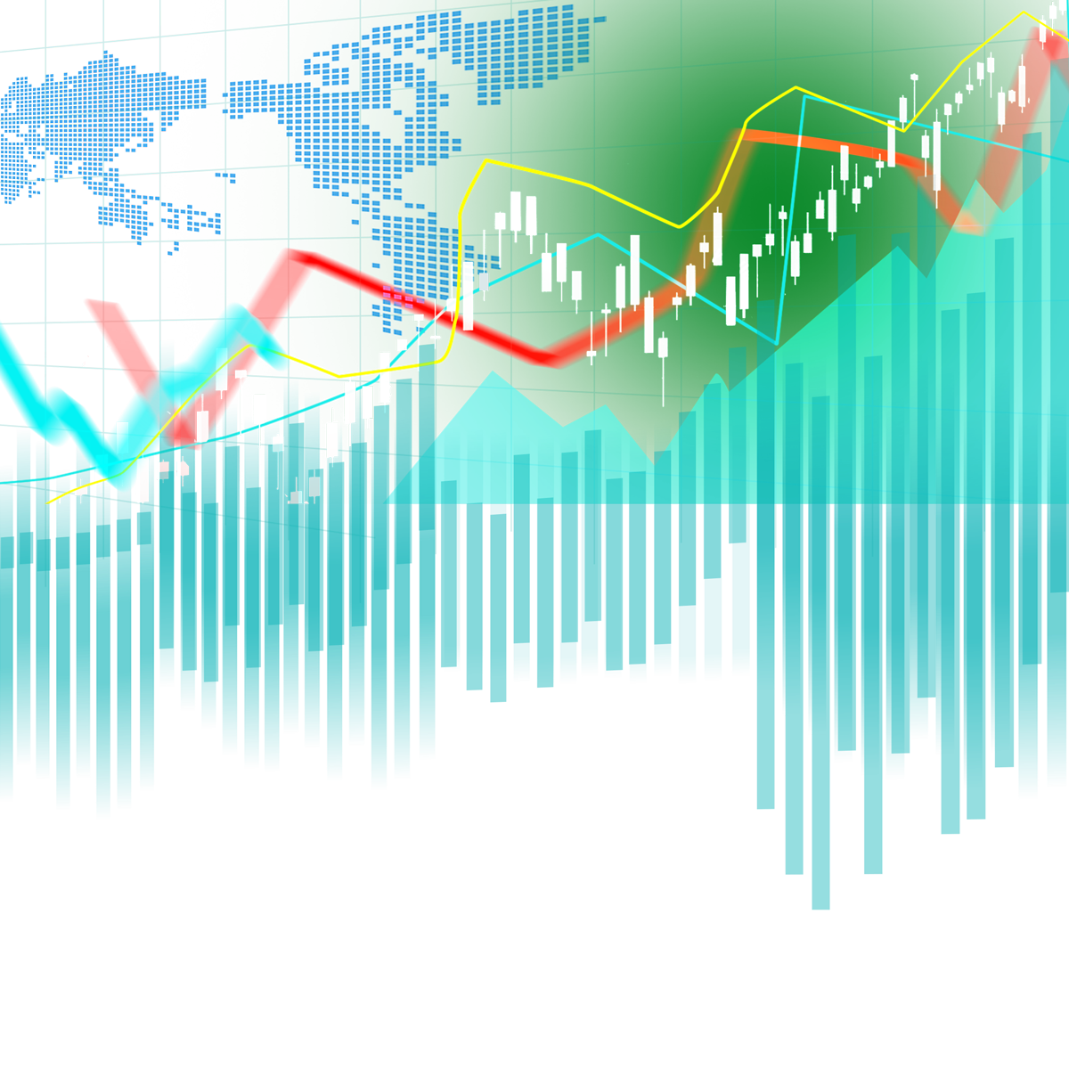
(Re-)Imag(in)ing Price Trends
USING CNN FOR STOCK MARKET FORECASTING
Ananth Mohan
Dhairya Dedhia
MGMT 590 - Machine Learning
February 2025

Slide 2
TRADITIONAL STOCK TRADING
“If a stock's price has dropped below resistance, wait for it to climb back above resistance before considering a buy.”
“Buy when the 50-day moving average crosses above the 200-day moving average”

Slide 3
RESEARCH GOAL & KEY QUESTIONS
Stock Market Prediction has been a long standing challenge due to the inherent volatality of financial data
Traditional Methods
CNN-Based Prediction
Manual (Indicators, Moving Averages)
Statistical Models (ARIMA, GARCH)
Predefined (Momentum, Mean-Reversion)
Limited to predefined rules
Automatic (Extracted by CNN)
Deep Learning (CNN)
Learned from Data
Adaptive & Scalable
Do CNNs outperform conventional financial prediction models?
How effective is image-based deep learning?
Notes:
Stock market prediction has been a long-standing challenge due to the inherent volatility of financial data. Traditional models, such as momentum and trend-based strategies, have relied on historical price trends but often fail to generalize. This research introduces an alternative approach by transforming stock price time-series data into images and applying deep learning-based Convolutional Neural Networks (CNNs) to predict stock price movements.

Slide 4

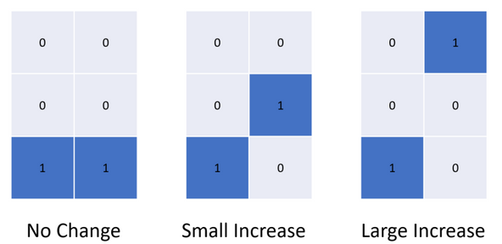
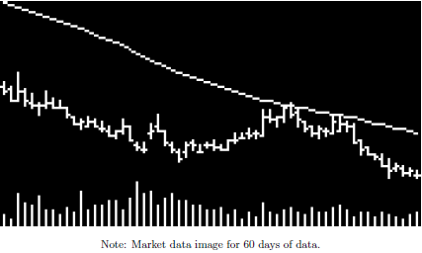

WHAT DOES THE PAPER SAY?
Data Collection
Data Processing
CNN Model
Prediction
Data Source - Yahoo Finance
Convert stock data to images
Apply moving averages & indicators
Prepare data for CNN input
Will the stock go up or down in next n days
Variables:
Open, High, Low, Close, Volume
CNN Model can observe visual changes

Slide 5
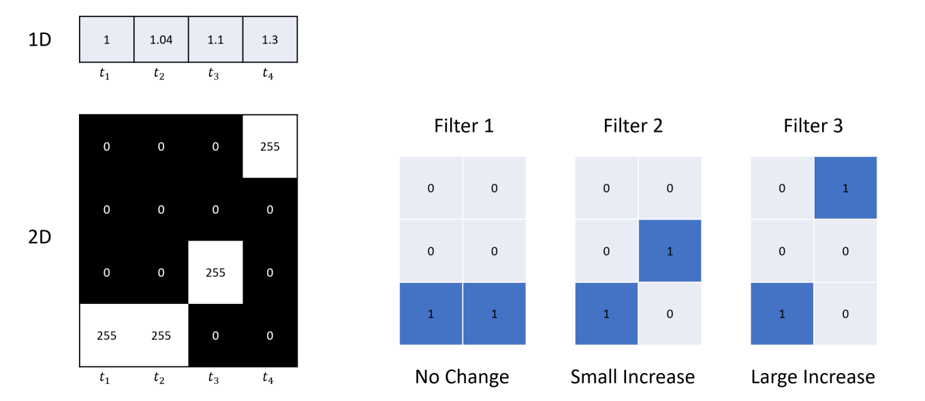
ADVANTAGE OF 2D CNN VS. 1D TIME SERIES DATA
Time Series Data
CNN can identify degree of change

Slide 6
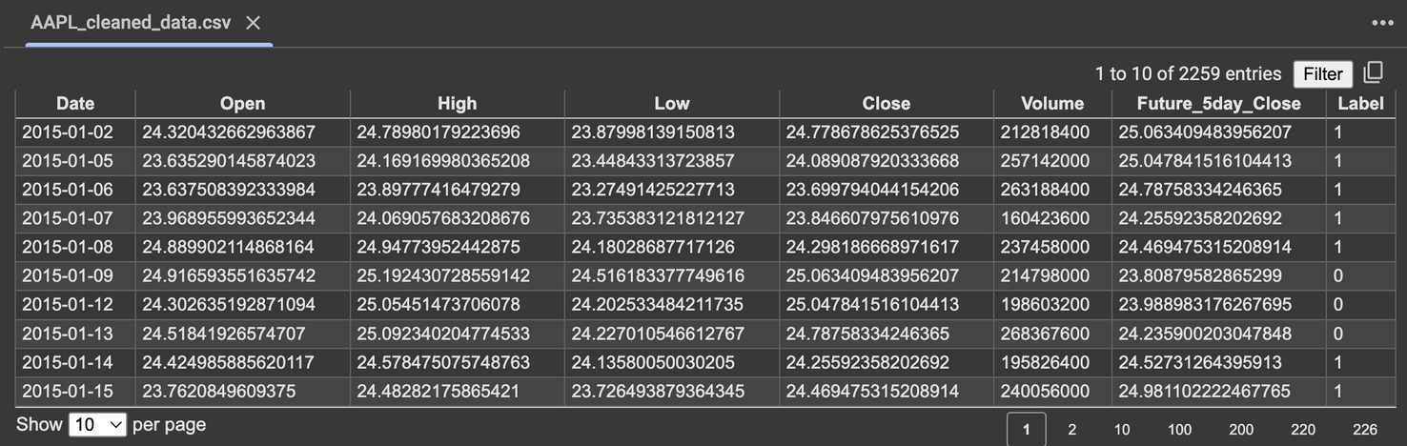
DATA COLLECTION
Source
Yahoo Finance
CRSP
Variables
Open price (O)
High price (H)
Low price (L)
Close price (C)
Trading volume (V)
Derived Variables
Future_5day_Close
Label (Up or Down)

Slide 7

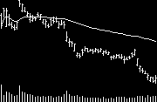
DATA PROCESSING
Normalize stock prices
Generate OHLC candlestick charts.
Overlay moving averages (5-day, 20-day, 60-day).
Save images in fixed dimensions (32x15, 64x60, 96x180 pixels).
Week (5-day Image)
Month (20-day Image)
Moving Average
Candle stick values
Volume
Quarter (60-day Image)

Slide 8
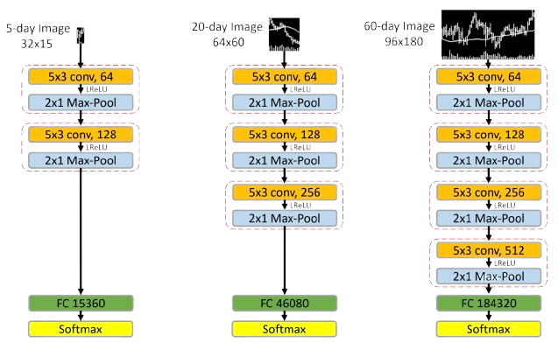
CNN ARCHITECTURE
 | 5-day | 20-day | 60-day
Input Size | 32*15 | 64*60 | 96*180
Convolutional Layers | 2 (64,128 filters) | 3 (64, 128, 256 filters) | 4 (64, 128, 256, 512 filters)
Fully Connected Dense Layer | 15,360 Neurons | 46,080 Neurons | 184,320 Neurons

Slide 9
MODEL TRAINING
Data Splitting
Model Training
Regularization & Optimization
Prediction & Evaluation
Training (1993-2000): 70% images
Validation (1993-2000): 30% images
Testing (2001-2019)
Classification Task: Predict Up (1) / Down (0)
Loss Function: Cross-Entropy Loss
Optimizer: Adam
Learning Rate: 10^-5
Xavier Initialization (Prevent vanishing/exploding gradients)
Batch Normalization (Reduces covariate shift)
Dropout (50%) (Prevents overfitting)
Early Stopping: Stops if no improvement in 2 epochs
Final model predicts return probability.
Tested on 19 years (2001-2019).
Picked Limited Stocks due to computing limitations:
Amazon [AMZN]
Apple [AAPL]
Alphabet [GOOGL]
Training (2015-2024): First 70% images
Validation (2015-2024): 20% images
Testing (2015-2024): Last 10%
5-day image -> 1-day prediction
What we did

Slide 10
INTERPRETABILITY-CRUCIAL YET A CHALLENGE
CNNs extract complex patterns from non-linear transformations which makes it hard to trace decision-making as they don’t provide clear factor contributions.
Financial analysts need explainable insights, not just predictions.
Method #1: Comparison to Financial Signals
Week Model with WSTR:(-) 26 to 34% correlation
Quarter Model with Momentum: 21% correlation
Method #2: Logistic Regression Comparison
Logistic Regression on 5-day with OHLC produced 22-35% explainability (McFadden R-squared, Log-Likelihood)
Method #3: Traditional Technical Analysis
Compared CNN Model with 23 popular trend patterns
13 of them have a significant association
8 of them went against conventional stock wisdom
CNN Models capture much more intricate patterns than conventional rules and metrics
CNN Model, oblivious to these Human-Engineered features, picked these up!!!!
We don’t know what’s happening in CNN!

Slide 11
TESTING THE RELIABILITY OF CNN MODEL
Different Model Architectures Tested
Varying CNN layers (more layers vs. fewer layers).
Different filter sizes (small vs. large convolution kernels).
Alternative Input Features Tested
Removing trading volume: Slight performance drop.
Removing moving averages: CNN still performs well, meaning it learns smoothing automatically.
Different price scaling methods: No major impact.
Testing Against Other Machine Learning Methods
Compared to Histogram of Oriented Gradients (HOG) and HAAR-like features.
Traditional image-processing methods fail to match CNN performance.
Testing in Different Time Periods
CNN trained on 1993-2000, tested on 2001-2019.
Predictions remain valid, proving CNNs generalize over time.
The CNN model demonstrates strong generalizability across different markets

Slide 12

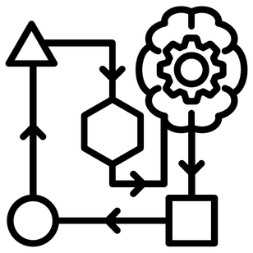
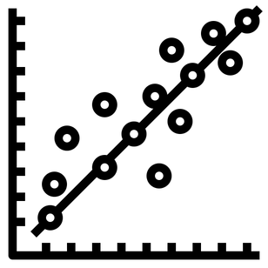
FUTURE RECOMMENDATIONS
Can the model be made interpretable?
Could Hybrid CNN-RNN models be used for sequential learning?
Can this be extended from classification to regression, by predicting actual return values?

Slide 13
Thank you for your attention!

